Slide 1
Tips on job Interview
Eng. Bahiah Maaitah

Slide 2
Part One – Before the Interview
• Do your homework! Learn as much as you can about the company or college before the interview.
• Know where you are going. Drive by the site of the interview a day or two before the interview.
• Arrive 5 – 15 minutes early.
• Be prepared when you go to the interview. Bring extra copies of your resume, your portfolio, a notepad with some questions prepared for the interview, and a pen.
• Dress for Success! Hair should be clean and combed. Fingernails must be clean with no gaudy polish. Keep perfume, cologne and aftershave to a minimum. Brush your teeth and don’t forget deodorant.

Slide 3
cont
• Women: dress, skirt (not too short), or dress pants with a nice blouse or blazer. No excessive jewelry, make-up, or “big hair.”
• Men: pants (not jeans!), collared shirt, tie,A suit is not always necessary.
• Do not wear loud clothes! Be conservative!

Slide 4
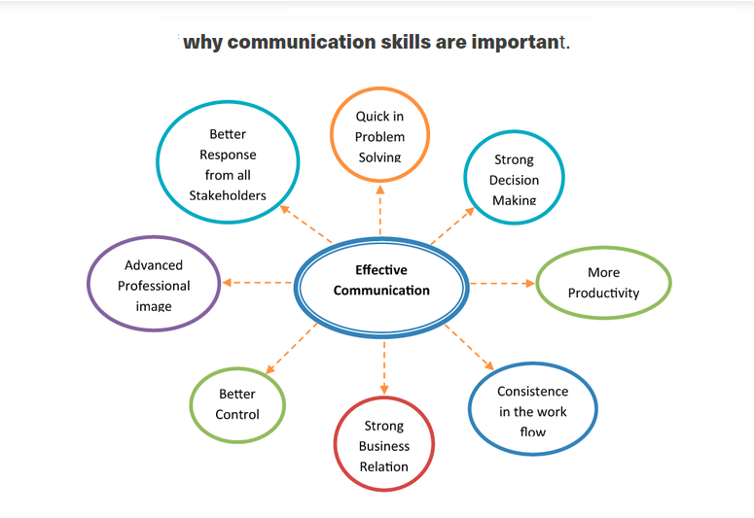

Slide 5
Part Two – The Start
• Inform the secretary/receptionist that you have an interview, whom it is with, and the time of the interview.
• When you meet the interviewer, look straight into his/her eyes, shake hands firmly, introduce yourself, smile, be confident and wait until you are offered a seat.
• Be positive in your communication (Remember: You’re selling yourself!!), don’t slouch, try not to be too bold or too shy. Let the interviewer lead the interview. Express that you are happy to have the opportunity to interview.
• When all else fails: SMILE!!

Slide 6
Be aware
• DO NOT:
Smoke, chew gum, curse, slouch, put your hands on items on the interviewer’s desk, fidget with rings, pens, ties, change, or other items in your reach.

Slide 7
Part Three – The Interview
• Always face the interviewer with good posture and body language.
• Stay positive with your attitude and your answers. Let the interviewer know about the skills, knowledge and experience that make you a qualified candidate.
• Know your resume and portfolio well and be prepared to answer questions about them.
• Be honest with all answers.
• Be thorough with your answers. Never answer with just a “yes” or “no.” Always provide explanations and examples.
• If you don’t understand the question, ask the interviewer to explain• Always face the interviewer with good posture and body language.

Slide 8
cont
• Stay positive with your attitude and your answers. Let the interviewer know about the skills, knowledge and experience that make you a qualified candidate.
• Know your resume and portfolio well and be prepared to answer questions about them.
• Be honest with all answers.
• Be thorough with your answers. Never answer with just a “yes” or “no.” Always provide explanations and examples.
• If you don’t understand the question, ask the interviewer to explain

Slide 9
cont
• Pay close attention to what the interviewer is saying.
• Organize your thoughts before speaking. Feel free to think for a moment about tough questions. Silence is not a bad thing as long as you do not take an excessive amount of time.

Slide 10
• DONOT:
Emphasize your weaknesses.
Draw attention to negative attributes such as poor attendance, grades, being fired, etc.
Criticize former employers, co-workers, or school personnel.
Discuss personal issues, good or bad, which are irrelevant.
Discuss salary or benefits unless the interviewer brings it up first.
Remember that you represent a risk to the employer. A hiring mistake is expensive. Show you are highly motivated and energetic.

Slide 11
Part Four – End of Interview
• Ask the job-related questions you prepared for the interview.
• You may be offered the job immediately. In that case, you should ask about specific salary, benefits, and work hours. You do not have to give them an immediate answer. Ask for a day to think about it.
• If you are told you will be contacted, ask about how long it will be. Offer to call in a few days to find out the decision. This shows your continued interest.

Slide 12
cont
• Make sure the interviewer knows how best to contact you and that you are available for any additional information that may be needed.
• Thank the person for the interview and their interest in you as a potential employee or student. Shake hands firmly on the way out.

Slide 13
Part Five – The Follow-Up
Part Five – The Follow-Up
• Send the interviewer a thank-you letter soon after the interview.
• Call the company or college about a week after the interview to find out if they have made a decision. If they have not, find out when they expect to have a decision.

Slide 14
Why People Are Not Hired
• Poor personal appearance
• Inability to communicate clearly, poor voice, and grammar
• Lack of planning for a career...no purpose or goals
• Lack of enthusiasm and confidence in the interview
• Condemning past employers

Slide 15
cont
• Failure to look the interviewer in the eye
• Limp handshake
• Late to the interview
• Does not thank the interviewer for his/her time
• Asks no questions
• Lack of knowledge about the business or the position

Slide 16
Average Interview Rating
10% Job Qualifications
40% Attitude
25% Appearance
25% Communication Skills

